Slide 1

Internet Air Conditioner Remote Controller

Slide 2
Content
Motivation
IoT Elements
Implemented Functions
Idea
Design
Future Work

Slide 3
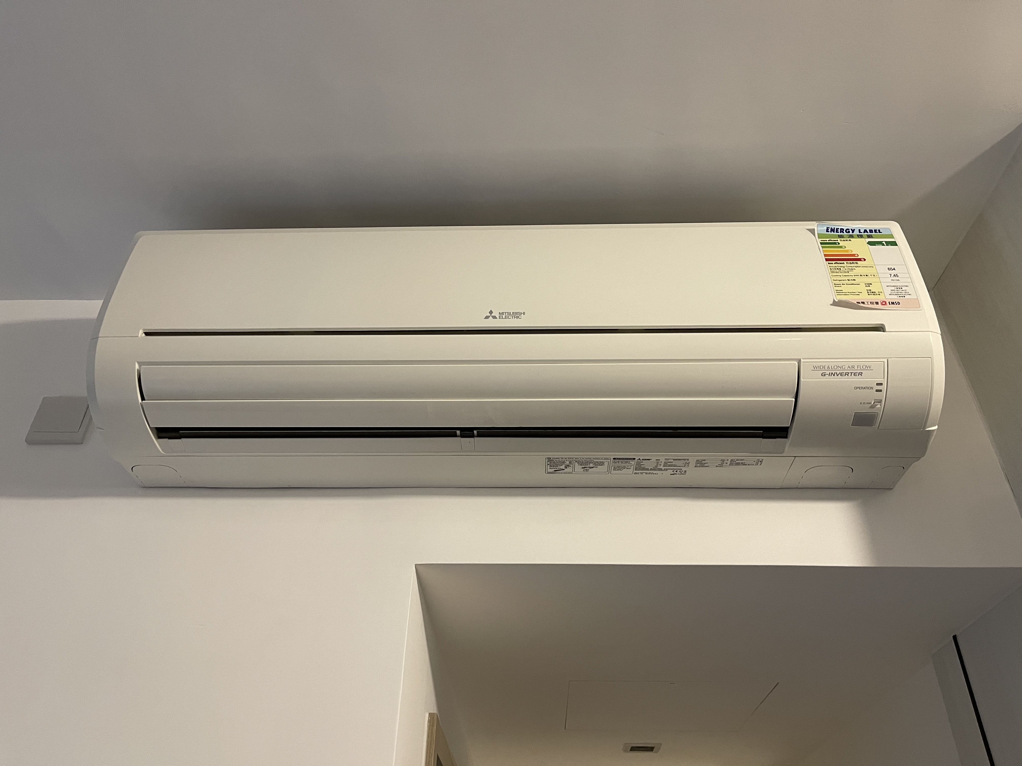
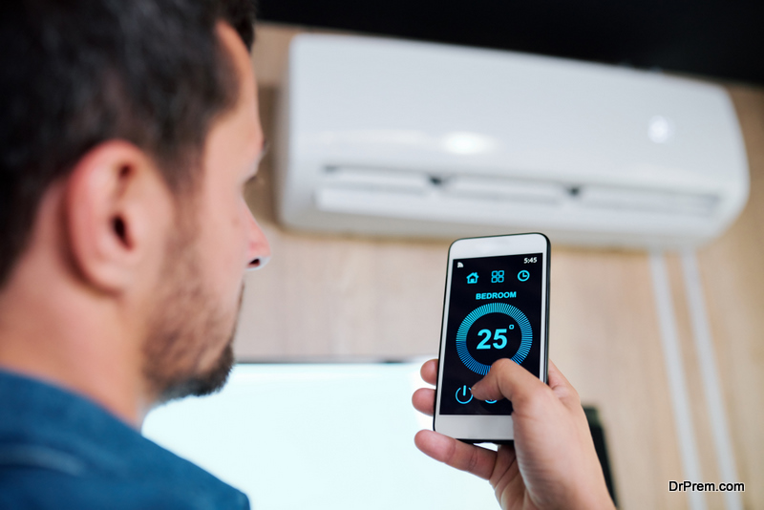
Motivation
Our air conditioner is a traditional air conditioner
Only can be controlled by controller
Can not be remotely controlled
Impossible for us improve traditional air conditioner to a smart conditioner
So, we designed a new Remote Controller in mobile phone
Air conditioner remote + Internet

Slide 4
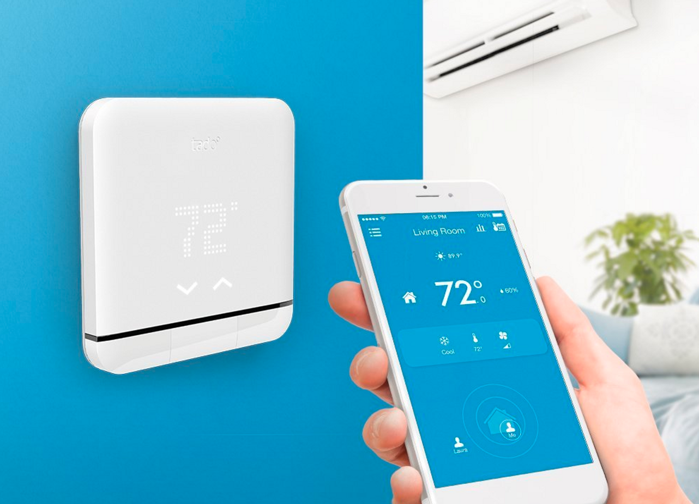
Idea
Main function in our remote controller mobile app
Display Current temperature and humidity
Temperature and wind can be remotely controlled
Mode can be remotely controlled
Can be controlled by voice

Slide 5
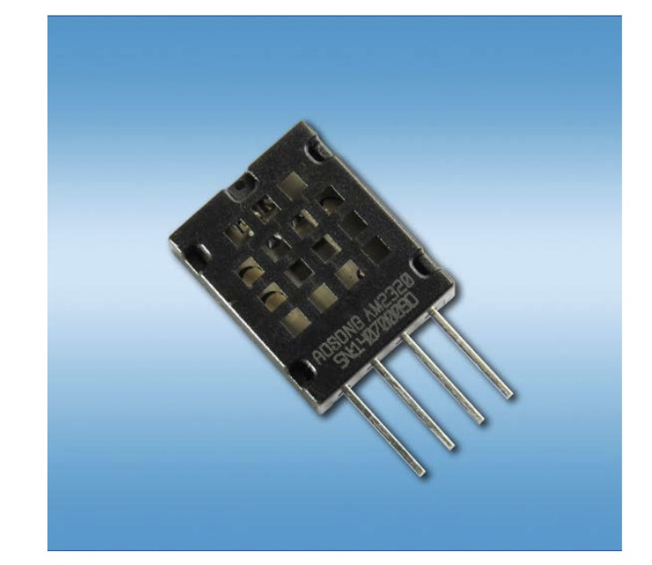
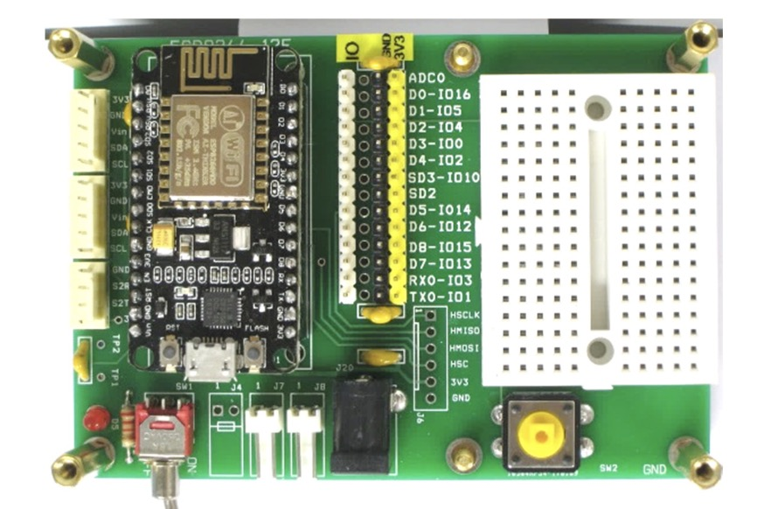
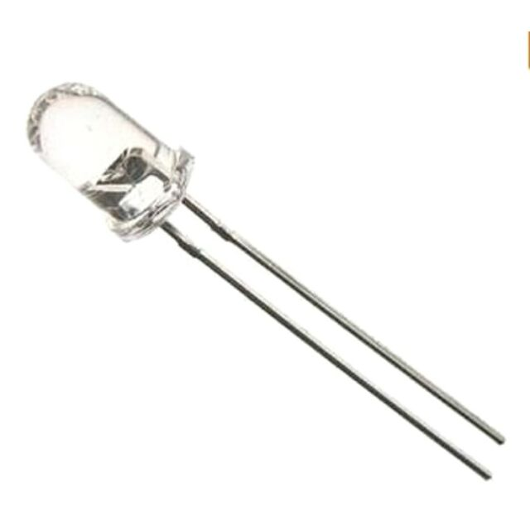
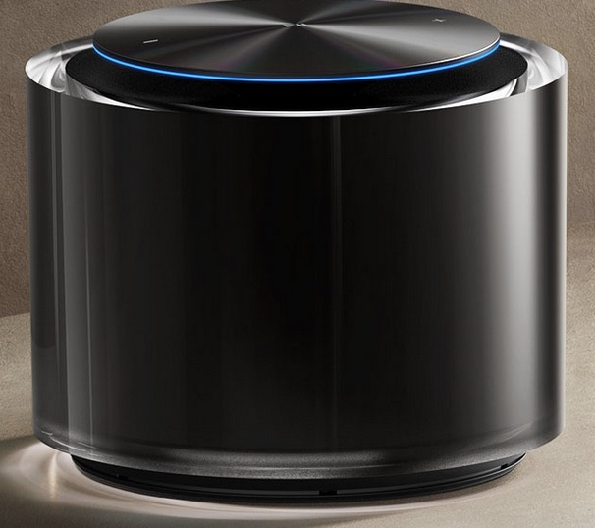
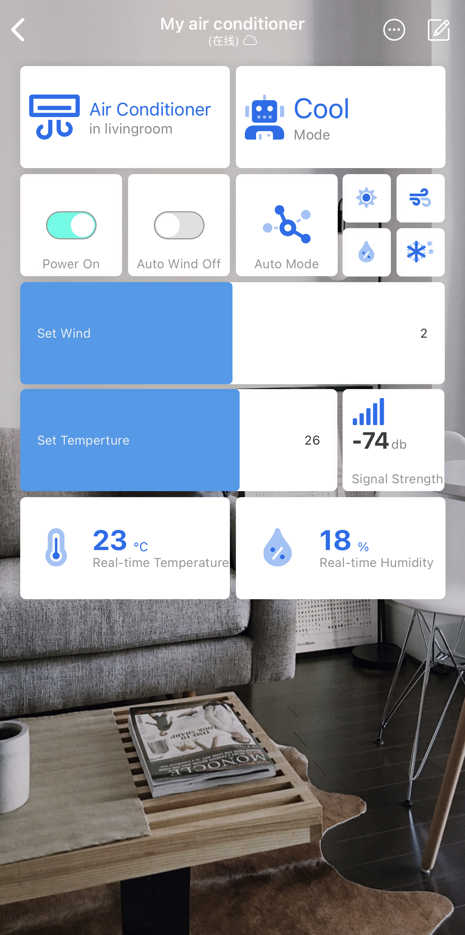
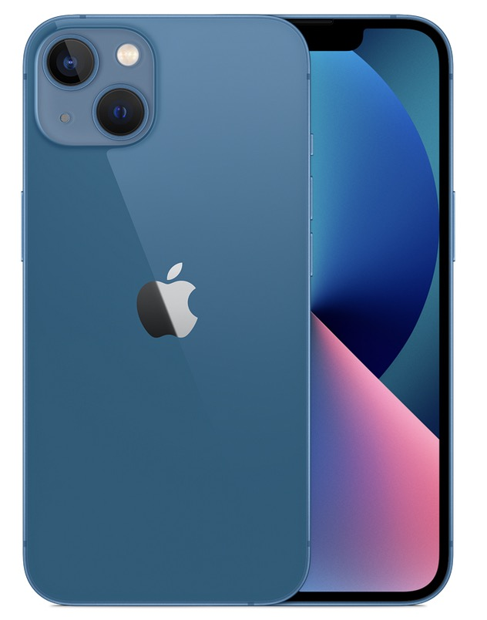
IoT Elements
-Sensor
Temperature and humidity Sensor (AM2320)
-Communication and Protocol
WiFi (IEEE 802.11)
Infrared (Infrared Data Association, IRDA)
-Input Device
Intelligent voice device
(For example, Xiaomi Sound）
Mobile phone
-Output Device
ESP8266
Infrared transmitter
-Application
Blinker

Slide 6
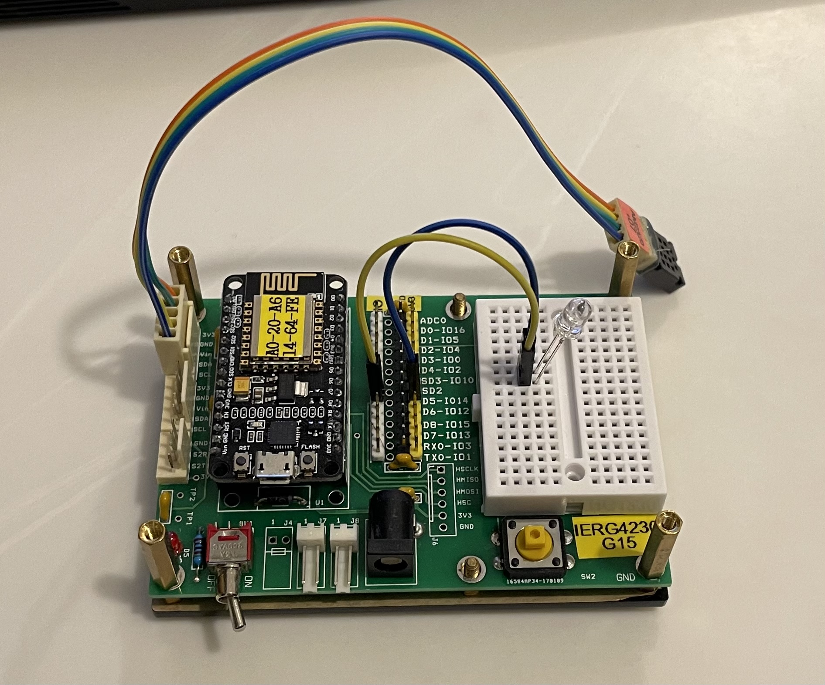
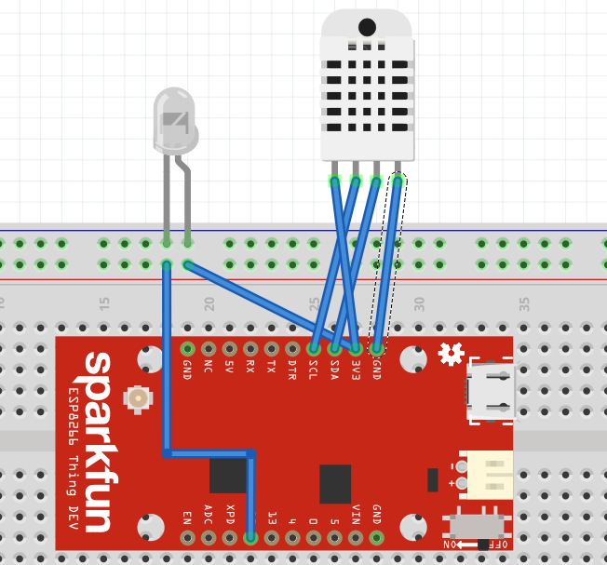
Design
ESP8266: Provide Wi-Fi communication and whole control
Temperature and humidity Sensor (AM2320): Detect real-time temperature and humidity
Infrared transmitter: Send remote control signal

Slide 7
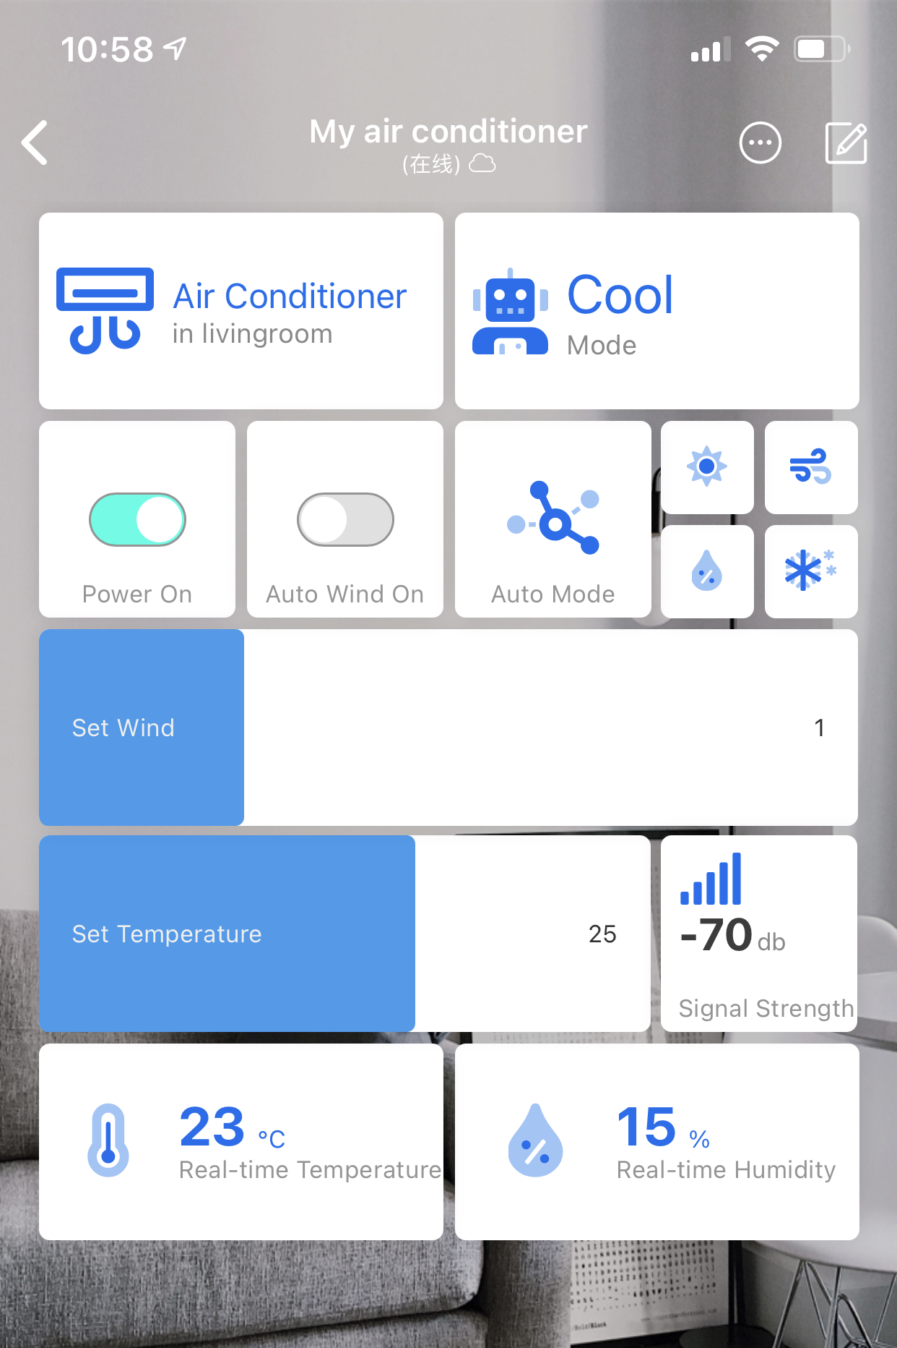
Implemented Function
Blinker
Display the current mode
Control the power and wind move
Switch the running mode
Set wind and temperature
Display the Wi-Fi signal strength
Display real-time temperature
Display real-time humidity

Slide 8
Demo Video

Slide 9

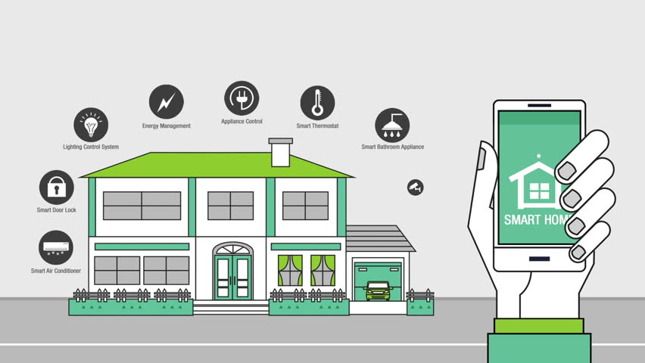
Future Work
Voice Control
Connected with some smart voice recognition device
Control other electrical appliances
Control other appliances in the house, such as TVs, lights, washing machines, etc., with only one remote controller

Slide 10
Thank you

